Slide 1
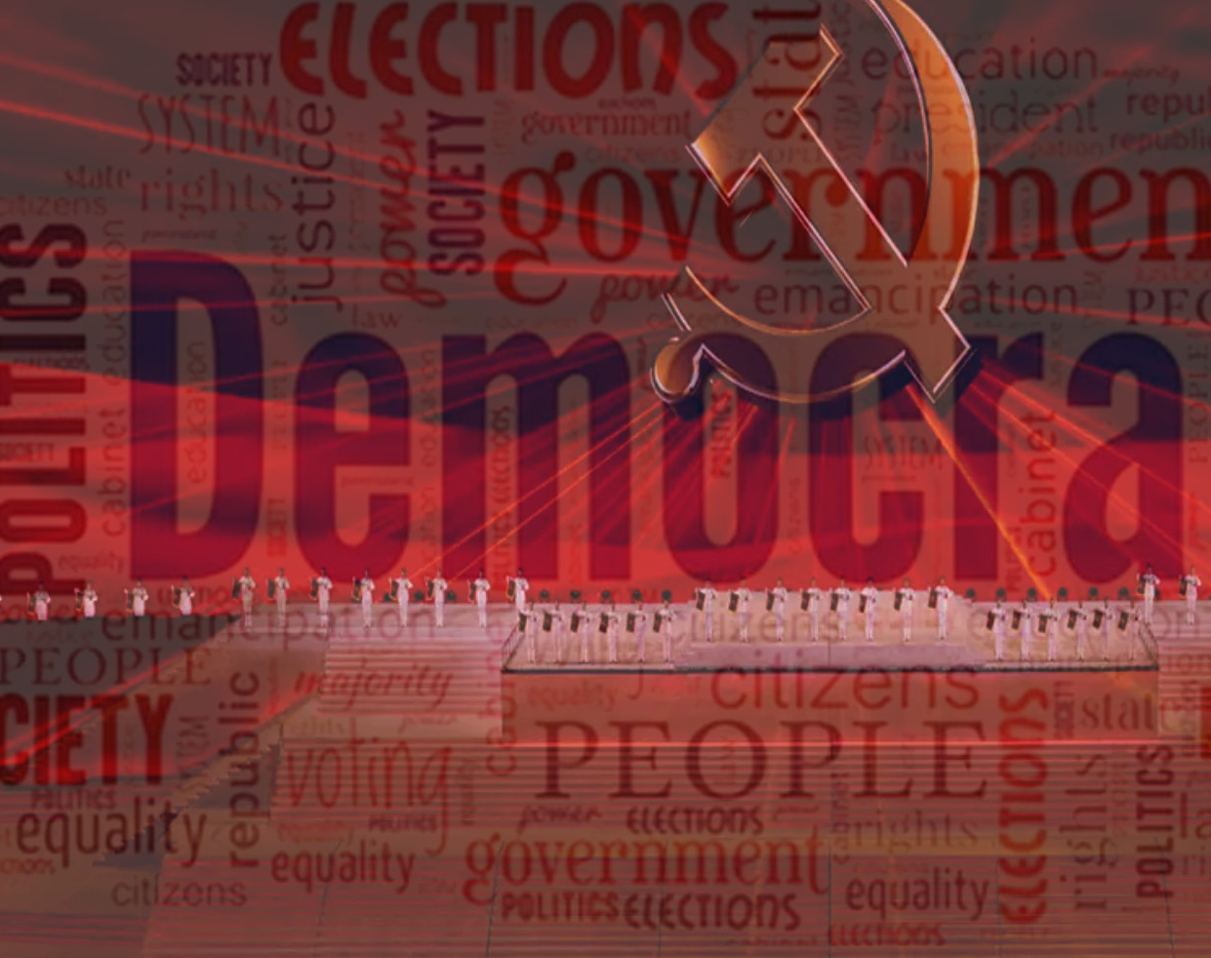
Week 5: Political regimes

Slide 2
Make your predictions!
Out of 179 countries in the world, how many are democracies?
2. What % of the world’s population currently lives in a democracy?
3. Is the world currently becoming more democratic (number of democracies increasing), or less democratic?

Slide 3
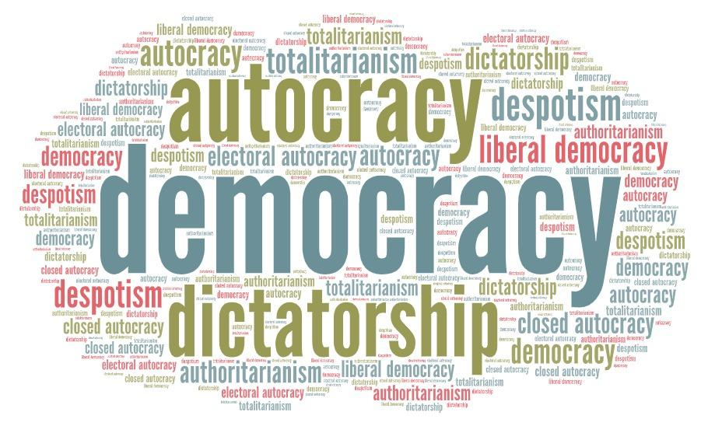
Regime types: conceptual chaos?

Slide 4
1. What is meant by ‘regime’?
Regimes are all about political power.
Regime = the system by which political power is allocated within a state.
This includes:
Horizontal dimension (division of powers)
Vertical dimension (power relationships between political power holders and citizens)

Slide 5

Dimensions of power relations
HORIZONTAL DIMENSION
division of powers
Executive (e.g. president, government administration)
Legislature (parliament)
Judiciary (courts, including any constitutional court)
civil liberties
VERTICAL DIMENSION
Citizens
Civil society

Slide 6


States > regimes > governments
TIME
STATE [name of country]
Regime 1
Regime 2
Regime 3
Individual governments

Slide 7
Name some a) formal and b) informal elements of a political regime.
Formal:
The constitution
Legal frameworks
Political institutions (e.g. parliament, the judiciary, political parties)
Informal:
Unwritten rules and political norms
Political behaviour
Patronage networks

Slide 8
What is an autocracy?
The word autocracy basically means ‘not a democracy’.
The most simple division of regimes divides them into two categories:
democracies
non-democracies (autocracies)
BUT!
The problem is this division is too simplistic to give us much information ☹

Slide 9
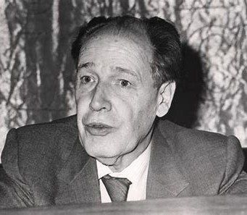
Who was the author of the book Totalitarian and Authoritarian Regimes (1975)? What categories did he classify regimes into?
Juan José Linz
democracies
authoritarian regimes
totalitarian regimes (and post-totalitarian (sub-category))
Linz: there are enough differences between authoritarian regimes and totalitarian regimes to justify categorising them separately.

Slide 10
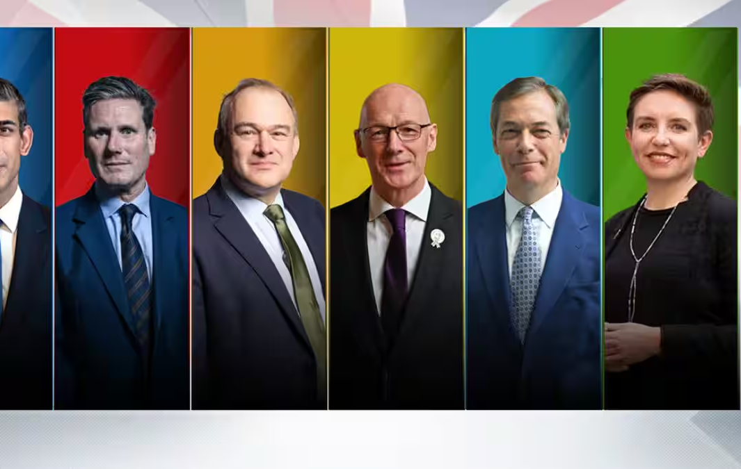
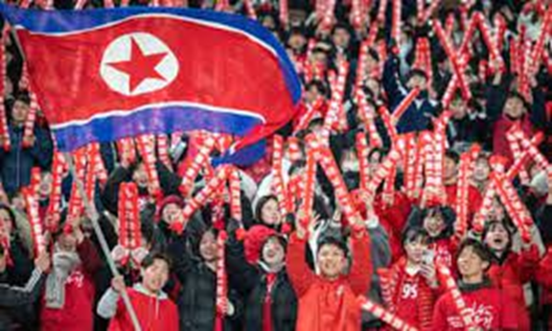
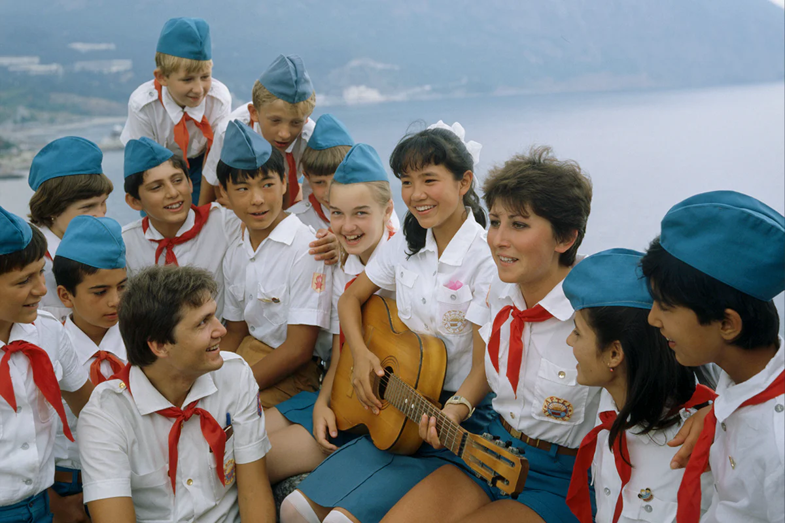
What is ‘political pluralism’? What is ‘political mobilization’?
Political pluralism:
different political groups, interests, and ideas coexist
they compete for power and influence over public policy
Political mobilization:
people are encouraged (or forced) to take part in political activity
e.g. joining political organizations, voting, taking part in demonstrations / parades

Slide 11
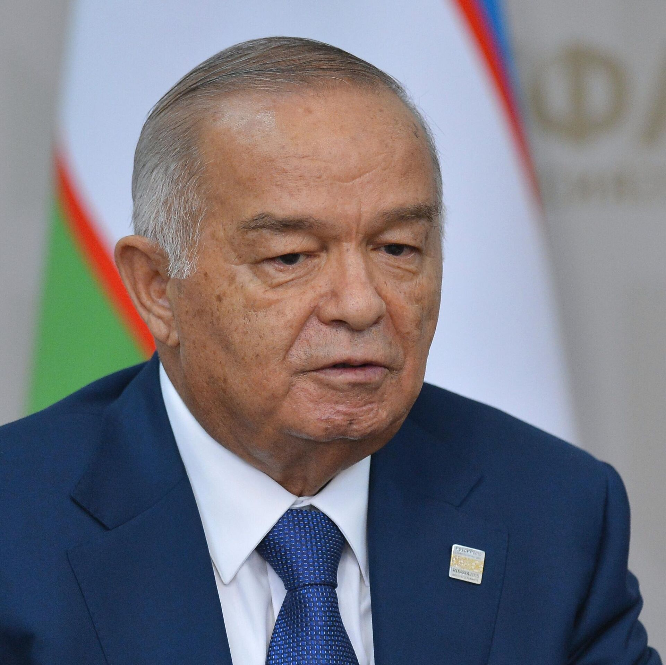
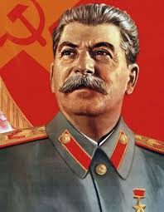

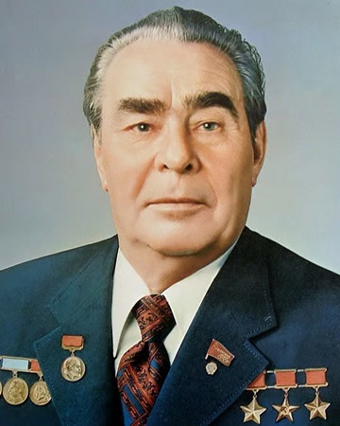
Analyse the following regime types according to the ideas of Juan Jose Linz
Authoritarian Vs Totalitarian
Totalitarian Vs Post-Totalitarian
What do they have in common?
What are the differences between them?
What things stay the same?
What is different in post-totalitarian regimes compared to totalitarian?

Slide 12

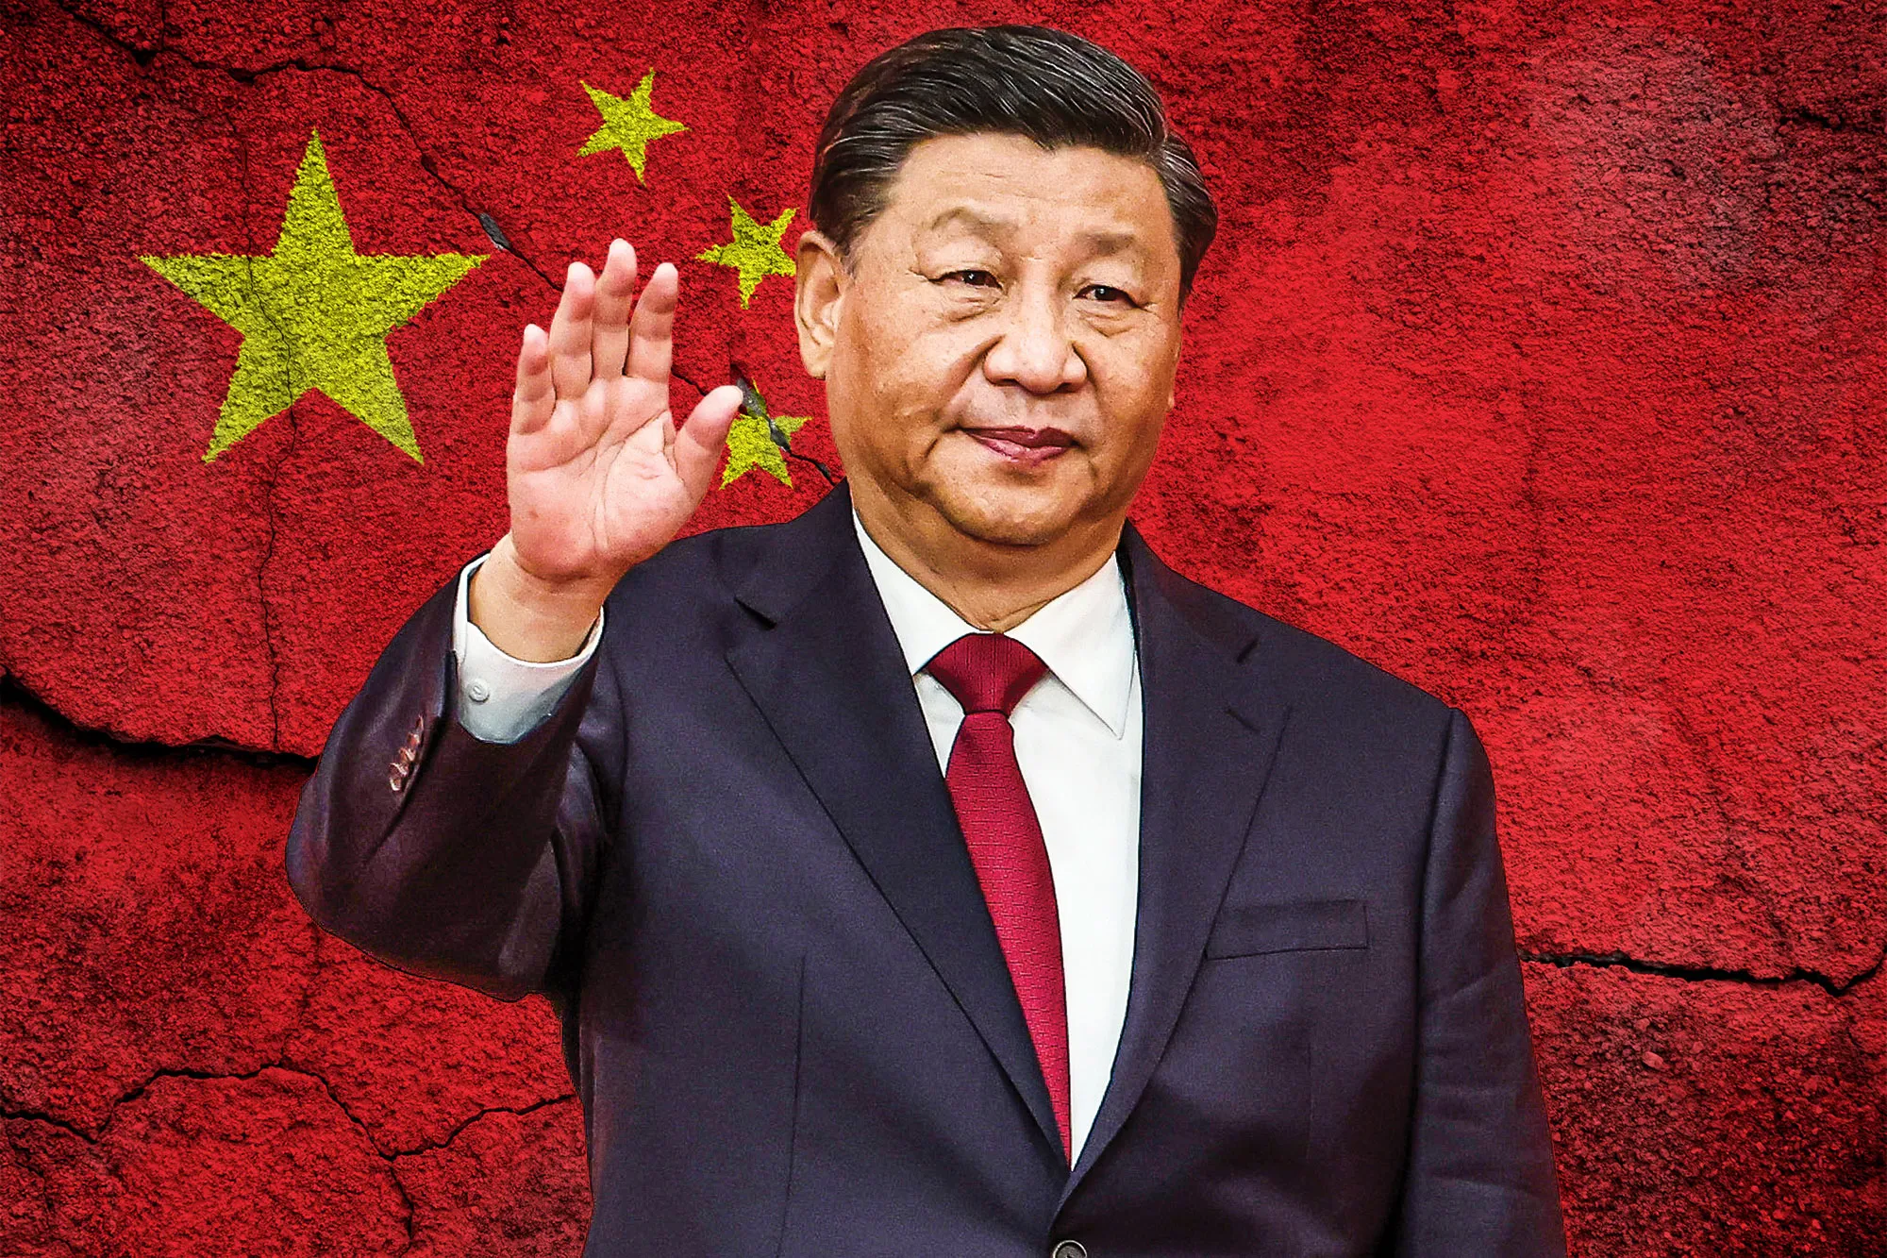
What do authoritarian and totalitarian regimes have in common?
Concentration of power in the hands of a leader or small ruling elite
No (genuine) democratic participation
No (or limited) political pluralism

Slide 13
According to Linz, what are the important differences between totalitarian and authoritarian regimes?
Factor | Totalitarian regimes | Authoritarian regimes
Political Pluralism
Ideology
Political Mobilization

Slide 14
According to Linz, what are the important differences between totalitarian and authoritarian regimes?
Factor | Totalitarian regimes | Authoritarian regimes
Political Pluralism | None – single-party monopoly | Limited – some pluralism tolerated but tightly controlled
Ideology | Strong, guiding, utopian ideology | Either no ideology, or weak, pragmatic ideology
Political Mobilization | High – mass participation encouraged and enforced | Low – political passivity or apathy preferred

Slide 15
According to Linz, what are the important differences between totalitarian and authoritarian regimes?
Factor | Totalitarian regimes | Authoritarian regimes
Control of Society
Economic Control

Slide 16
According to Linz, what are the important differences between totalitarian and authoritarian regimes?
Factor | Totalitarian regimes | Authoritarian regimes
Control of Society | Total – attempts to penetrate all aspects of life (culture, economy) | Limited – allows some autonomy in non-political spheres
Economic Control | Often centralized, state-planned economy | Mixed economy – may include market economy with state dominance

Slide 17

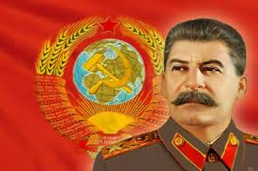
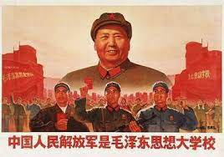
Totalitarian regimes
Linz argued that totalitarian regimes are entitled to a separate category because they are unique in simultaneously possessing ALL of the following:
an ideology
a single mass party
concentrated power in the hands of an individual or small group.
Authoritarian regimes might possess one or two of these characteristics, but they never possess all three simultaneously (they do not usually have an ideology).
Totalitarian regimes usually try to control all areas of citizens’ lives, including culture and people’s private lives.

Slide 18

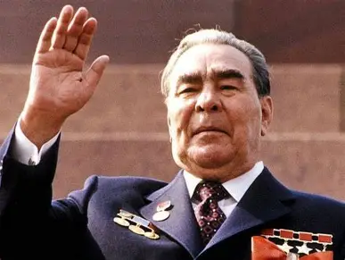
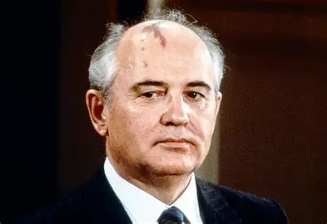
What did Linz mean by ‘post-totalitarian regimes’?
Post-totalitarian regimes:
Evolve out of totalitarianism
Keep many authoritarian structures (one-party rule, control of media)
But they soften the most extreme elements of totalitarian control:
Less repression and terror
Ideology becomes weaker
Less mobilization of citizens
Limited pluralism in non-political areas (e.g. culture, religion)

Slide 19
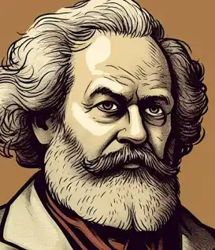
What is meant by a ‘teleological view of history’?
Teleological views of history sees historical events as having a purpose or goal.
History is seen as progressive: i.e. over time humanity gets closer to the ideal goal.
E.g. Karl Marx’s view of history: human societies pass through certain historical stages (e.g. capitalism, revolution), with ideal communist society as the final end point.

Slide 20
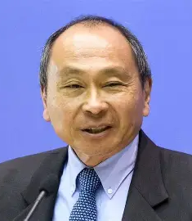
Who wrote the book The End of History and the Last Man (1992)? What did the author mean by ‘the end of history’?
Francis Fukuyama
The end of history = liberal democracy is the final form of government for all nations.
All countries are on a path to liberal democracy and will reach it eventually.
Humanity has reached “not just ... the passing of a particular period of post-war history, but the end of history as such: That is, the end-point of mankind's ideological evolution and the universalization of Western liberal democracy as the final form of human government.”

Slide 21
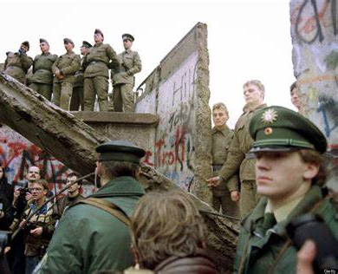
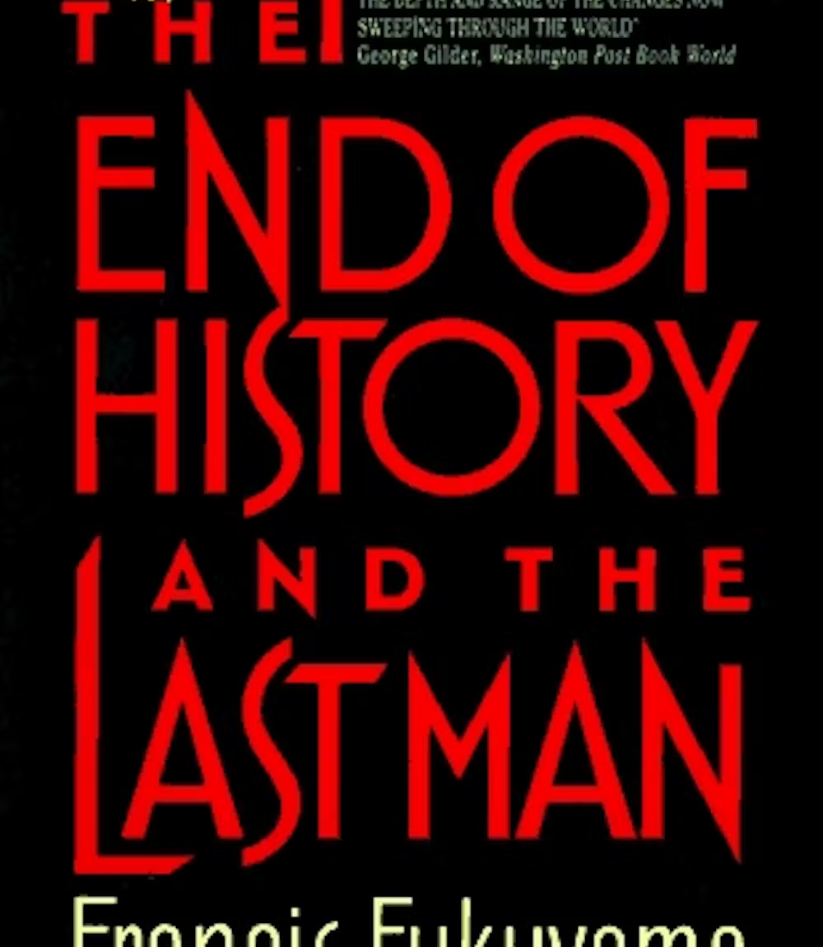
Which historical events influenced the thesis of ‘the end of history’?
The fall of the Berlin Wall
End of the Cold War
The collapse of the USSR and fall of communist regimes in the Eastern Bloc

Slide 22
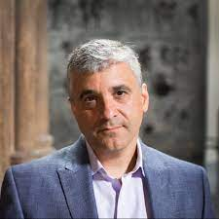
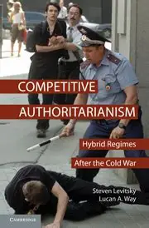
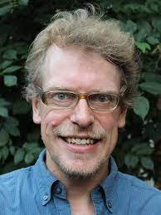
What criticisms have Steven Levitsky and Lucan Way made of the ‘end of history’ thesis?
They criticise the notion that all regimes are on a path to liberal democracy.
Authoritarian regimes should not be viewed as ‘incomplete’ or ‘transitional’ forms of democracy. We need to understand authoritarian regimes in their own right.
Many autocracies have proved stable and long-lasting.

Slide 23
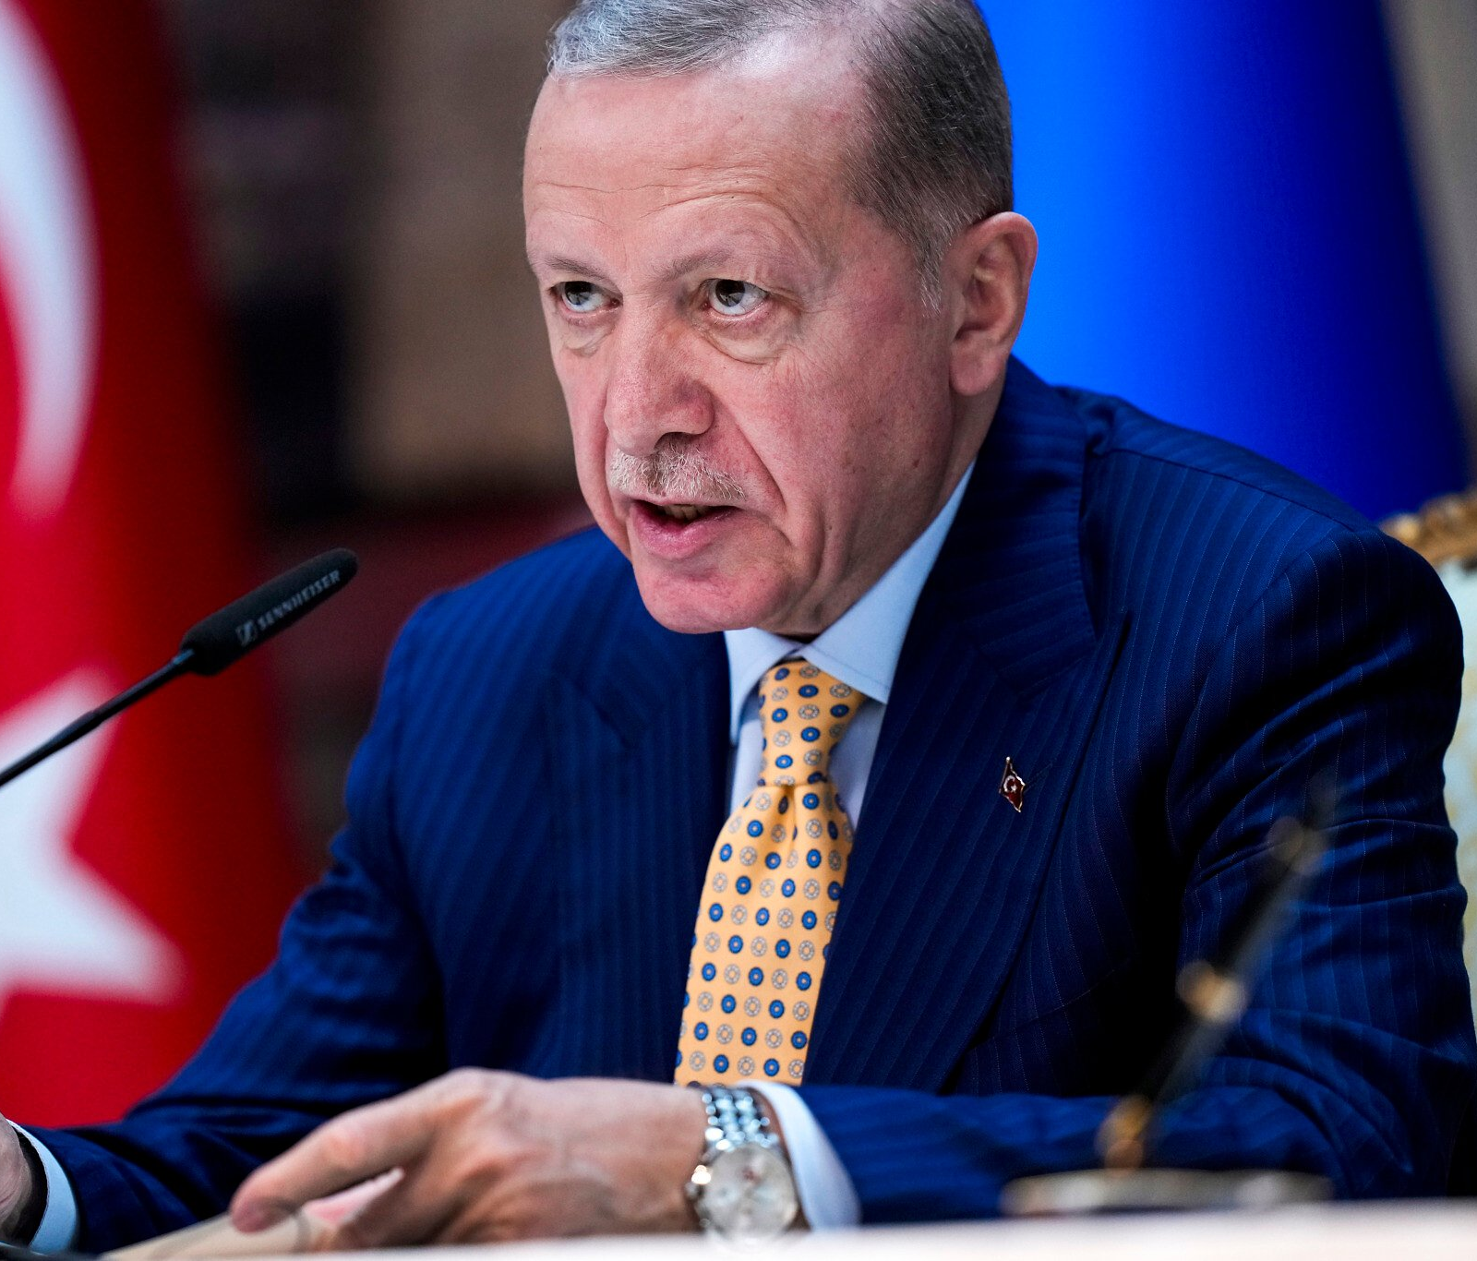
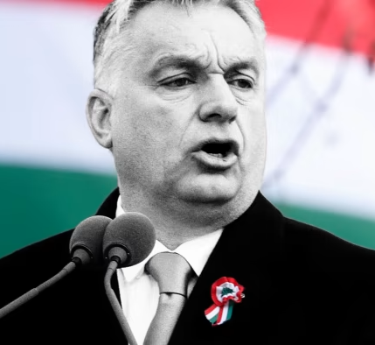
What do Steven Levitsky and Lucan Way mean by ‘competitive authoritarian regimes’?
Competitive authoritarian regime:
a system where democratic institutions exist in form and elections are regularly held. However, in practice the rules are unfairly applied to give significant advantages to those who already hold power.
They are a type of ‘hybrid’ regime (not full democracies, but not full authoritarian regimes either)
This regime type became more common in the 1990s and 2000s in post-Soviet countries and parts of Africa

Slide 24
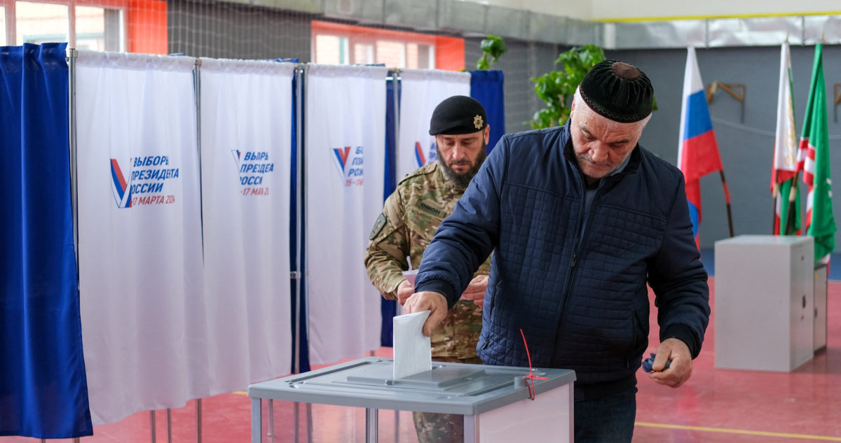
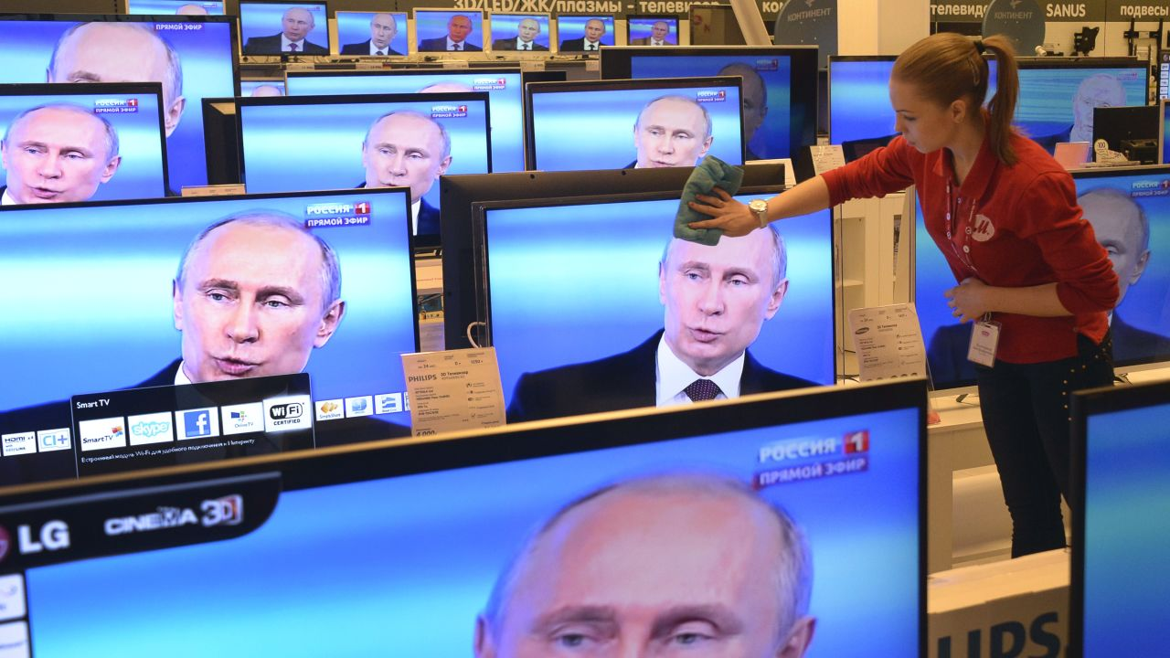
What are elections like in competitive authoritarian regimes?
Elections are not entirely fraudulent, meaning the results are not falsified
But they are unfair
Opposition groups may face repression and harassment from the authorities
Opposition parties also get little or no media coverage.
Some violations of electoral procedures, to the benefit of those currently holding power.
‘Competitive authoritarian’ because, despite the abuses of democratic procedures that take place, real competition for power still exists to some extent

Slide 25

What categories does Freedom House categorise regimes into?
Free
Partly free
Not free

Slide 26

What scale does Polity use to classify regimes?
From -10 (full autocracy)…
… to +10 (full democracy)

Slide 27

What categories does V-Dem’s Regimes of the World categorise regimes into?
Regimes of the World distinguishes four types of political systems:
closed autocracies
electoral autocracies
electoral democracies
liberal democracies

Slide 28
Summary of RoW’s classification criteria
 | Are there elections for president/ PM/ parliament? | Are the elections free, fair and meaningful? | Do citizens have full civil rights and are equal before the law? | Is there a separation of powers (legislative and judiciary can constrain the executive)?
Closed autocracy | No | n/a | No | No
Electoral autocracy | Yes | No | No | No
Electoral democracy | Yes | Yes | No | No
Liberal democracy | Yes | Yes | Yes | Yes

Slide 29
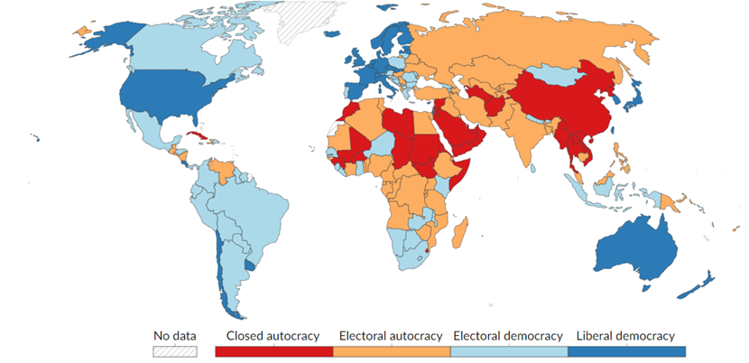
Political regimes worldwide: RoW, 2022

Slide 30
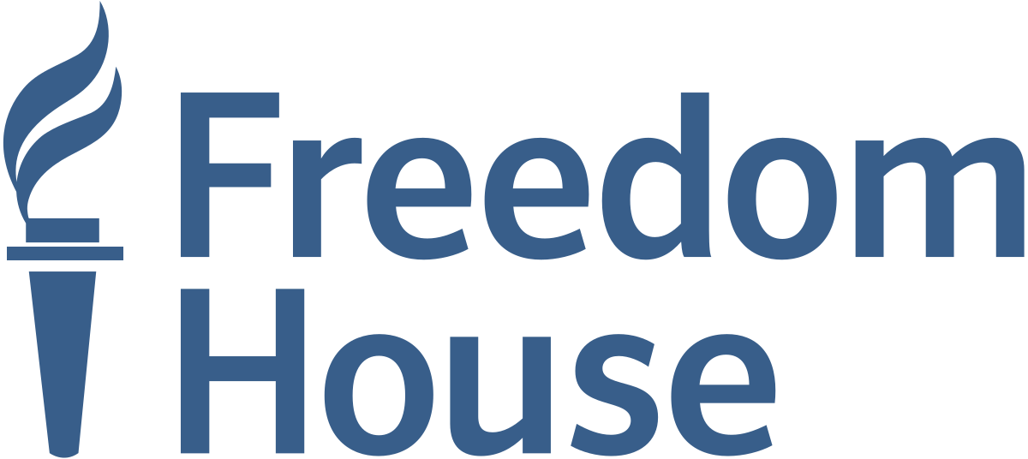


What criticisms have been made of regime indices published by Freedom House, Polity and V-Dem?
Lack of disaggregation (FH) – lots of different elements combined into one score
Subjective opinions of experts (ALL indices)
Lack of transparency in their methodology (FH and Polity) – we don’t know how they decide what score a country gets
Alleged Western bias (esp. FH, which receives funding from the US government)

Slide 31
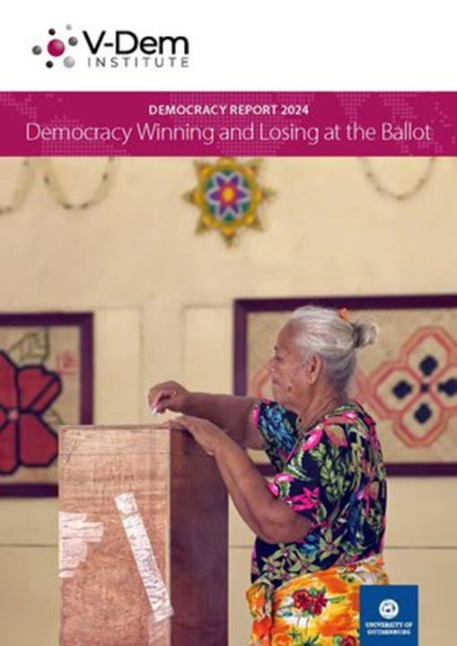
The V-Dem Institute
The V-Dem Institute is a research institute based at the University of Gothenburg in Sweden.
V-Dem = Varieties of Democracy
Produces quantitative indicators of many different aspects of democracy and government for every country in the world.
Publishes a yearly Democracy Report on democracy in the world.

Slide 32
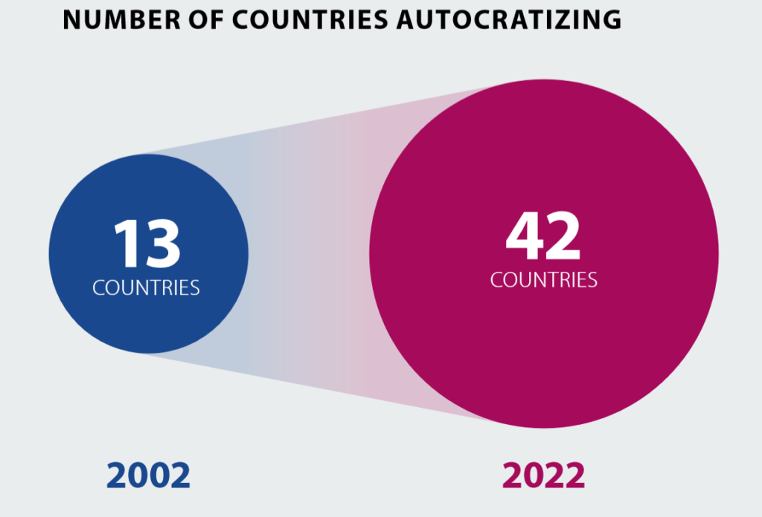
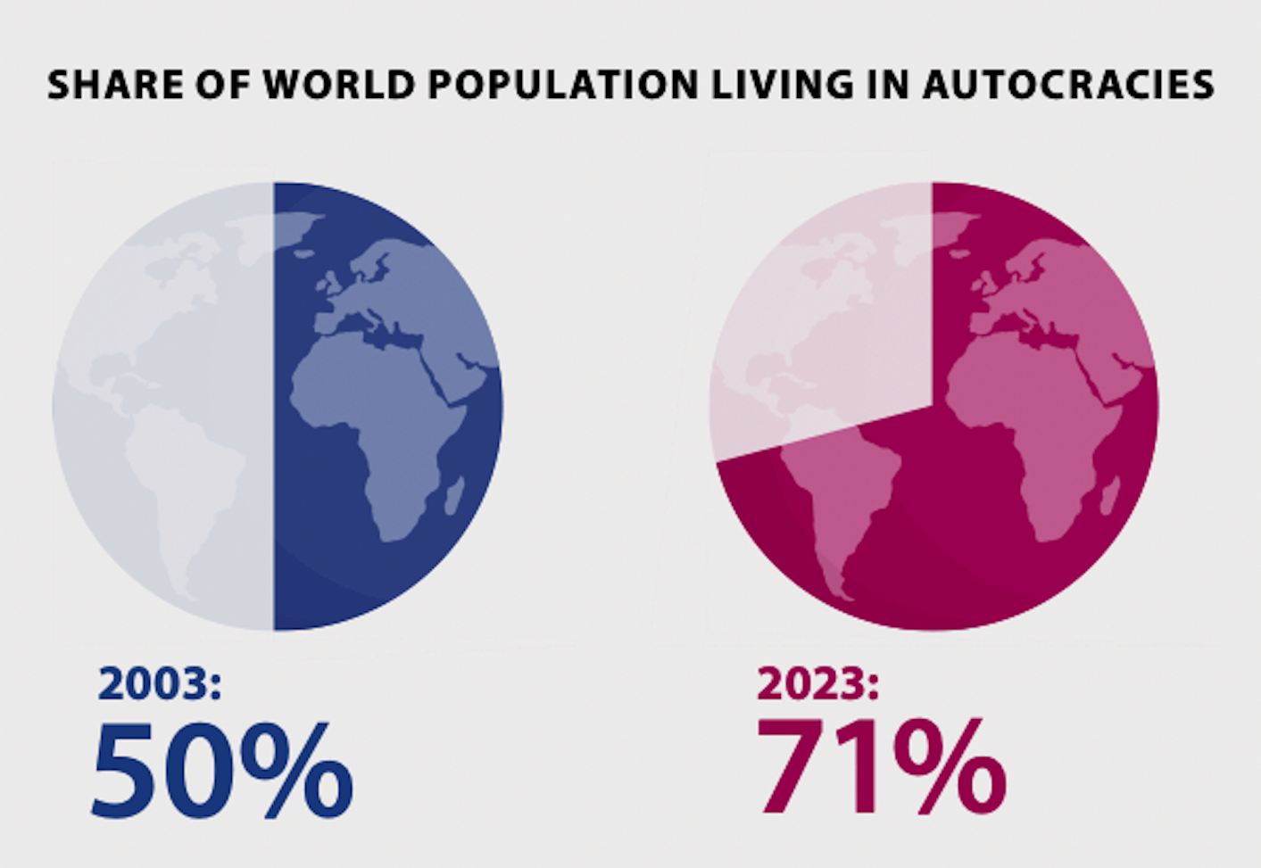
What are the two main ways V-Dem measures trends in regimes?
by country (count the number of countries of each regime type)
by share of global population (the % of the world’s population living in each regime type)

Slide 33
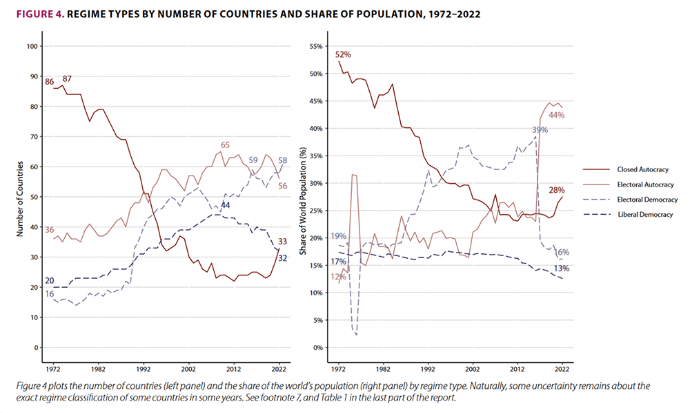
According to V-Dem’s Democracy Report 2024, what is the current global trend in political regimes – is democracy increasing or decreasing?
By both measures, democracy is decreasing:
Levels of democracy by country are now back to 1998 levels.
The level of democracy enjoyed by the average person in the world in 2023 is down to 1985-levels.

Slide 34
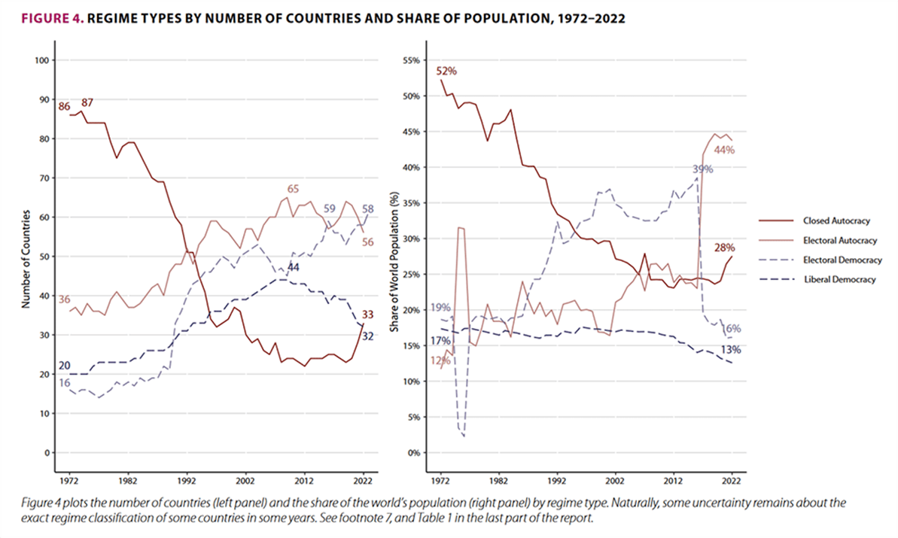

Slide 35
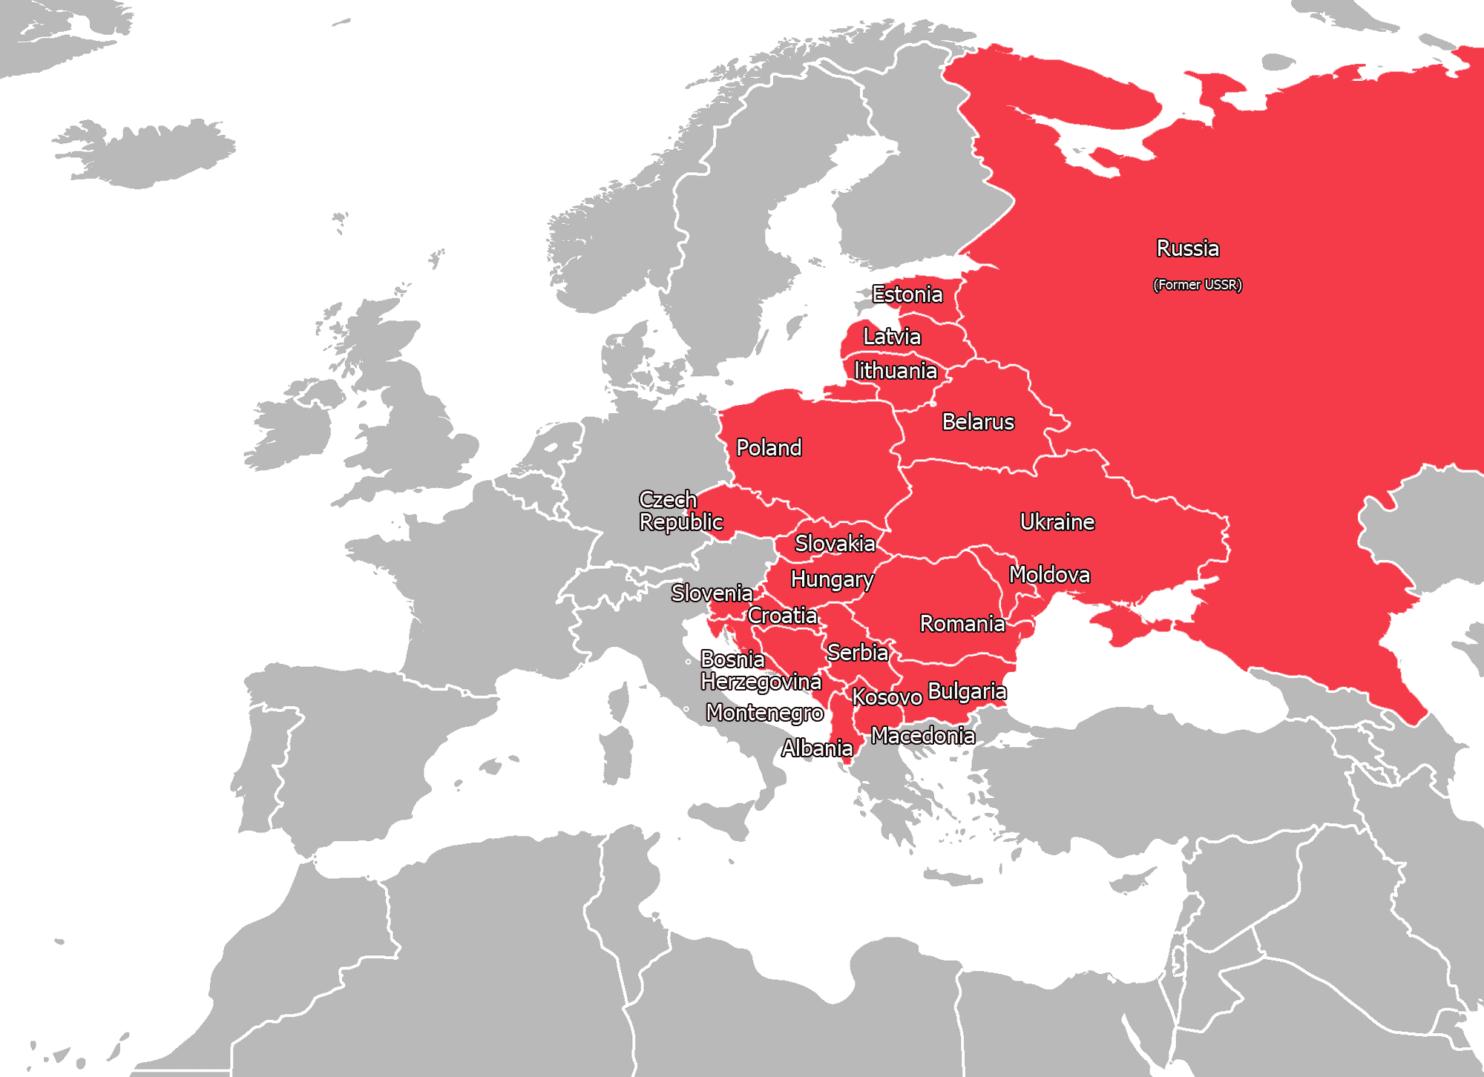
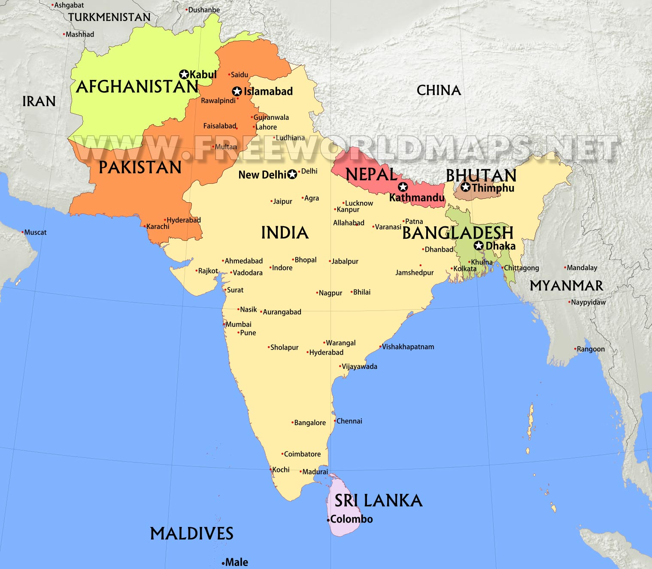
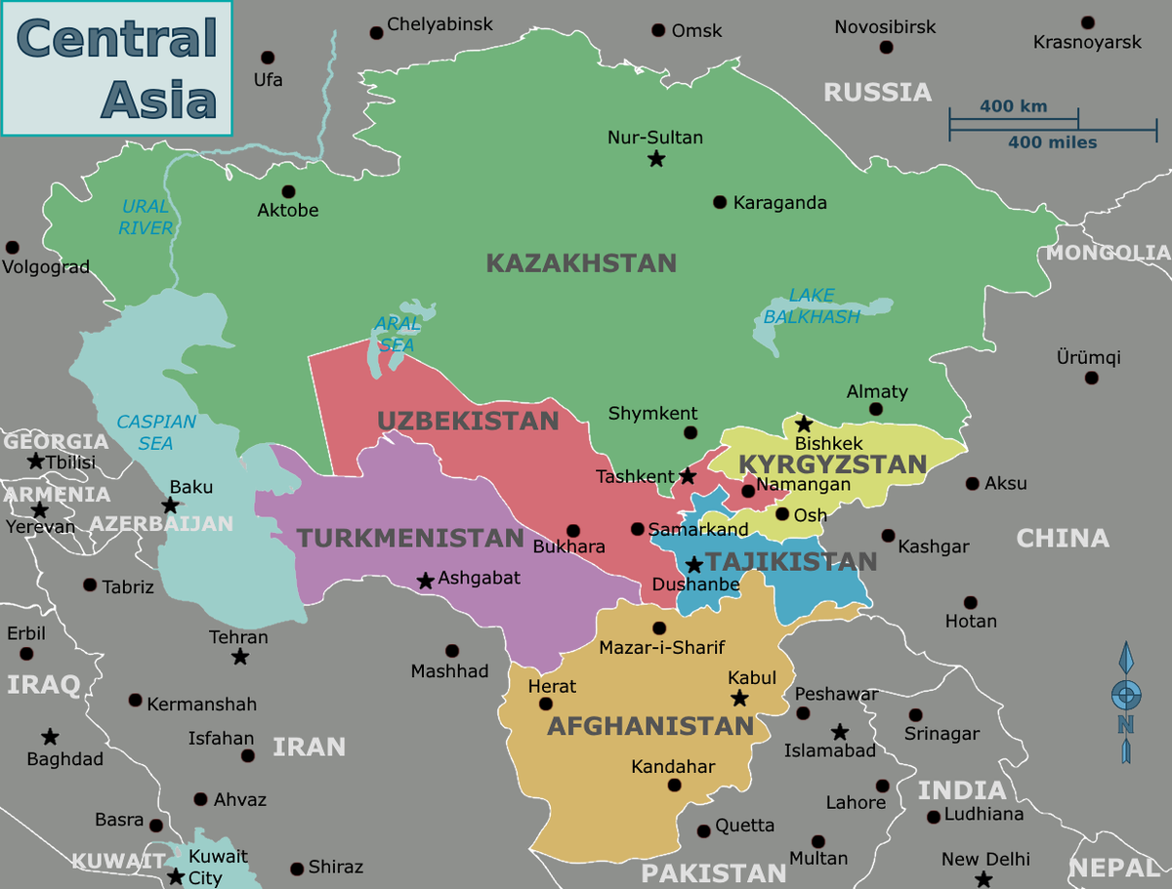
According to V-Dem (2024), in which regions of the world is democracy in decline?
Declining:
Eastern Europe
Central Asia
South Asia

Slide 36
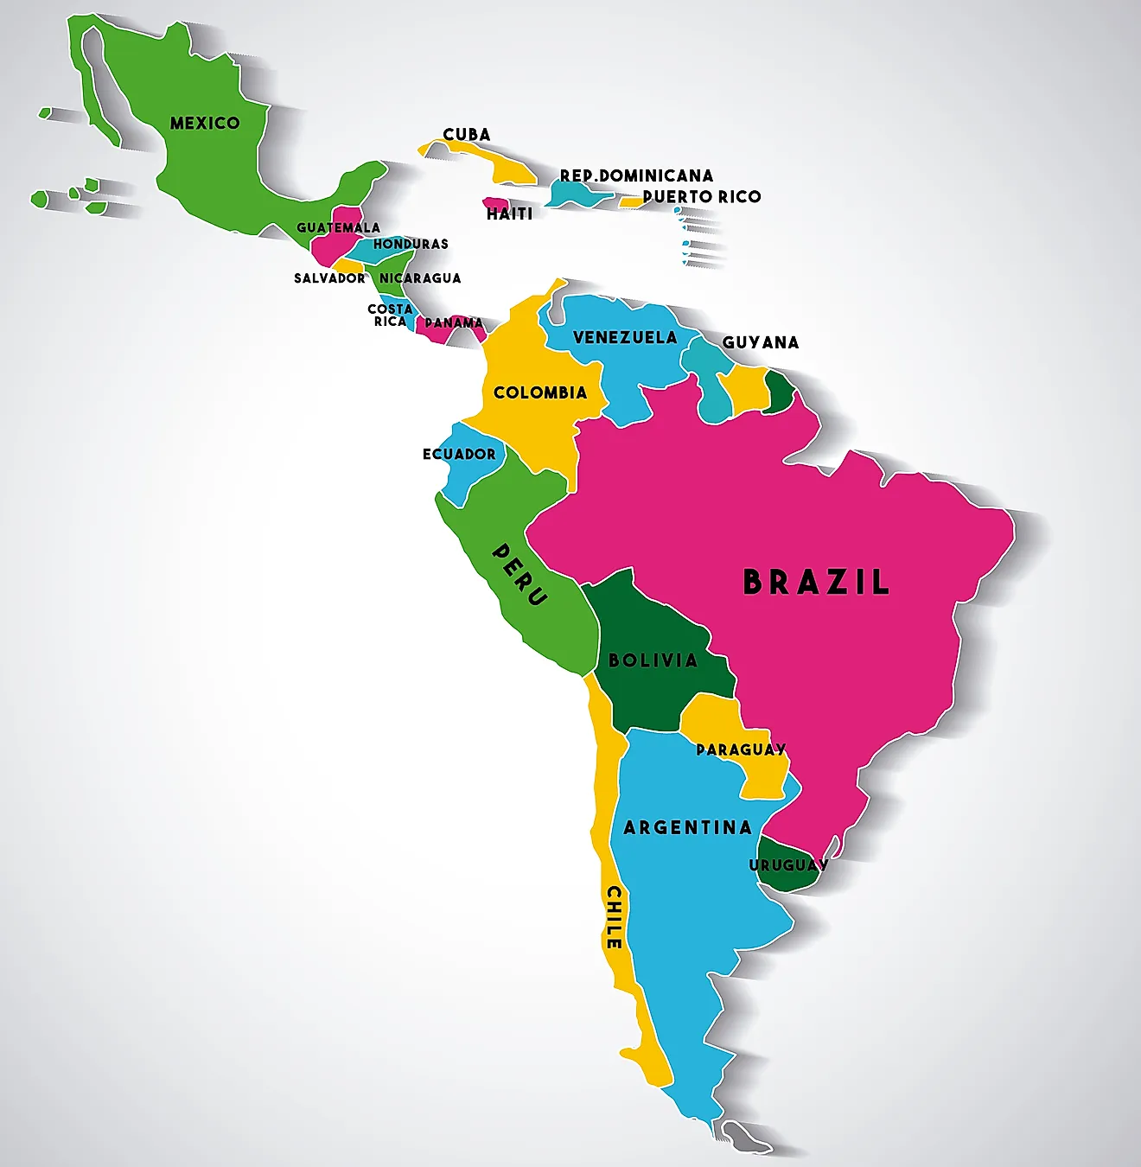
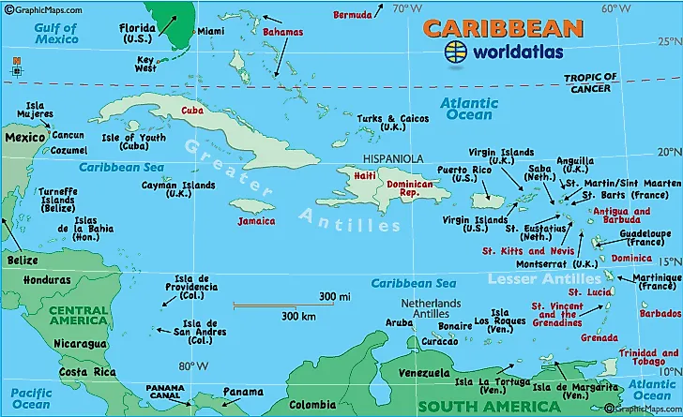
According to V-Dem (2024), in which regions of the world is democracy growing?
Growing:
Latin America
The Caribbean

Slide 37
Answers to the ‘prediction’ questions
1. Out of 179 countries in the world, how many are democracies?*
91 democracies (88 autocracies)
2. What % of the world’s population currently lives in a democracy?*
29%
3. Is the world currently becoming more democratic (number of democracies increasing), or less democratic?*
Less democratic
* According to V-Dem’s data

Slide 38
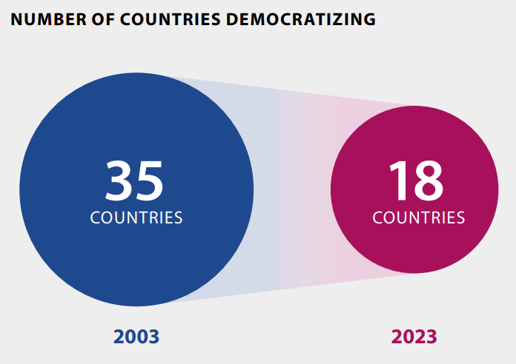
Current global trends
Source: V-Dem 2024

Slide 39
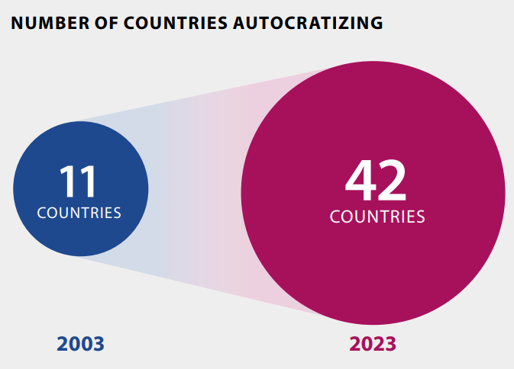
Current global trends
Source: V-Dem 2024

Slide 40
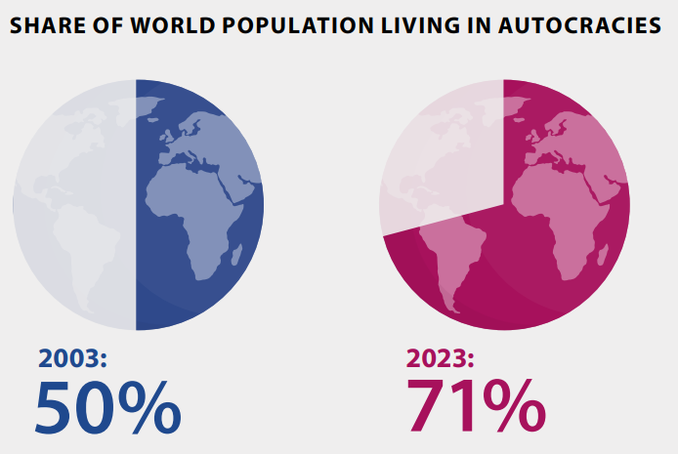
Current global trends
Source: V-Dem 2024

